Slide 1
Information Retrieval
Topic- Text Clustering
(Application of K-means clustering)
Lecture-37
Prepared By
Dr. Rasmita Rautray & Dr. Rasmita Dash
Associate Professor
Dept. of CSE

Slide 2
Text Clustering

Slide 3
Content
Clustering
Classification Vs Clustering
Applications of clustering in information retrieval
K-mean Clustering

Slide 4
Clustering: Definition
(Document) clustering is the process of grouping a set of documents into clusters of similar documents.
Documents within a cluster should be similar.
Documents from different clusters should be dissimilar.
Clustering is the most common form of unsupervised learning.
Unsupervised = there are no labeled or annotated data.

Slide 5
Classification vs. Clustering
Classification: supervised learning
Clustering: unsupervised learning
Classification: Classes are human-defined and part of the input to the learning algorithm.
Clustering: Clusters are inferred from the data without human input.
However, there are many ways of influencing the outcome of clustering: number of clusters, similarity measure, representation of documents, . . .

Slide 6
The cluster hypothesis
Cluster hypothesis. Documents in the same cluster behave similarly with respect to relevance to information needs.
All applications of clustering in IR are based (directly or indirectly) on the cluster hypothesis.

Slide 7
Applications of clustering in IR
Application | What is clustered? | Benefit
search result clustering | search results | more effective information Presentation to user
Scatter-Gather | (subsets of) collection | alternative user interface: “search without typing”
collection clustering | collection | effective information presentation for exploratory Browsing
cluster-based retrieval | collection | higher efficiency: faster search

Slide 8
Clustering for improving recall
To improve search recall:
Cluster docs in collection a priori
When a query matches a doc d, also return other docs in the cluster containing d
Hope: if we do this: the query “car” will also return docs containing “automobile”
Because the clustering algorithm groups together docs containing “car” with those containing “automobile”.
Both types of documents contain words like “parts”, “dealer”, “mercedes”, “road trip”.

Slide 9
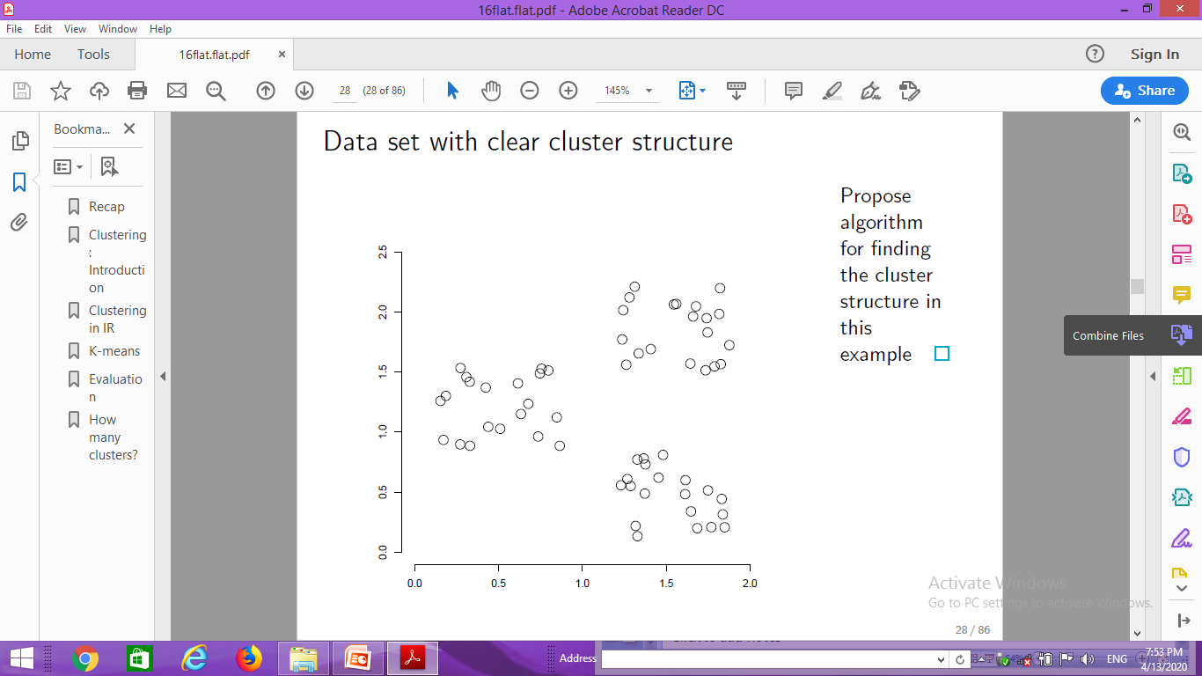
Data set with clear cluster structure
Cluster
structure

Slide 10
Desiderata for clustering
General goal: put related docs in the same cluster, put unrelated docs in different clusters.
We’ll see different ways of formalizing this.
The number of clusters should be appropriate for the data set we are clustering.
Initially, we will assume the number of clusters K is given.
Later: Semiautomatic methods for determining K
Secondary goals in clustering
Avoid very small and very large clusters
Define clusters that are easy to explain to the user
Many others . . .

Slide 11
Flat algorithms
Flat algorithms compute a partition of N documents into a set of K clusters.
Given: a set of documents and the number K
Find: a partition into K clusters that optimizes the chosen partitioning criterion
Global optimization: exhaustively enumerate artitions, pick optimal one
Not tractable
Effective heuristic method: K-means algorithm

Slide 12
K-means
The best known clustering algorithm
Simple, works well in many cases
Use as default / baseline for clustering documents

Slide 13
Document representations in clustering
Vector space model
As in vector space classification, we measure relatedness
between vectors by Euclidean distance . . .
. . .which is almost equivalent to cosine similarity.
Almost: centroids are not length-normalized.

Slide 14
K-means: Basic idea
Each cluster in K-means is defined by a centroid.
Objective/partitioning criterion: minimize the average squared difference from the centroid
Recall definition of centroid:
where we use ω to denote a cluster.
We try to find the minimum average squared difference by iterating two steps:
reassignment: assign each vector to its closest centroid
recomputation: recompute each centroid as the average of the vectors that were assigned to it in reassignment

Slide 15
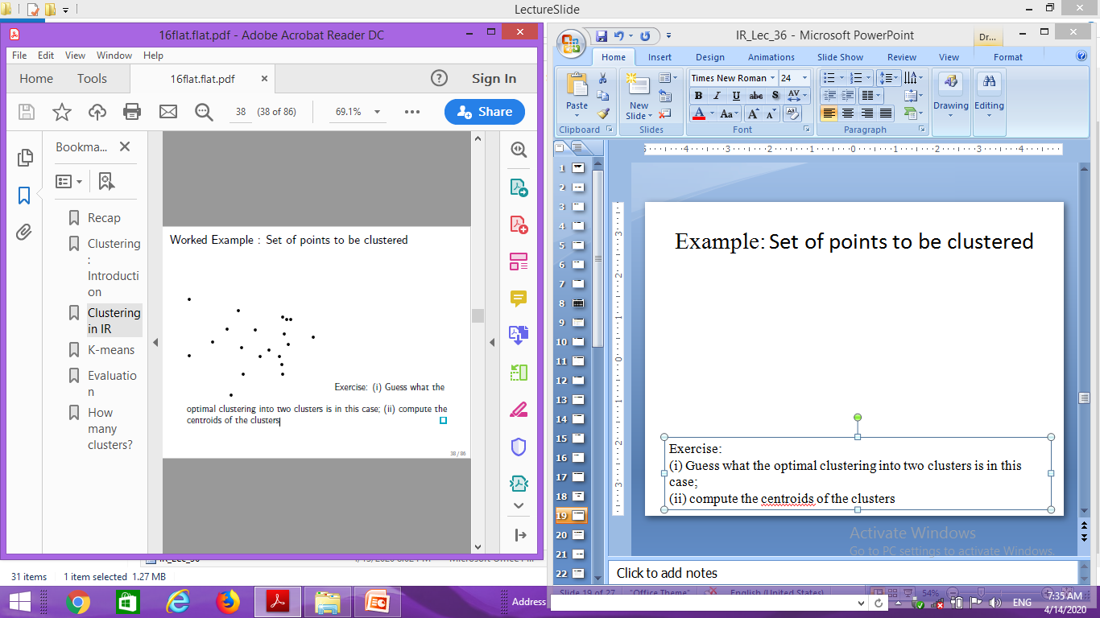
Example: Set of points to be clustered
Exercise:
(i) Guess what the optimal clustering into two clusters is in this case;
(ii) compute the centroids of the clusters

Slide 16
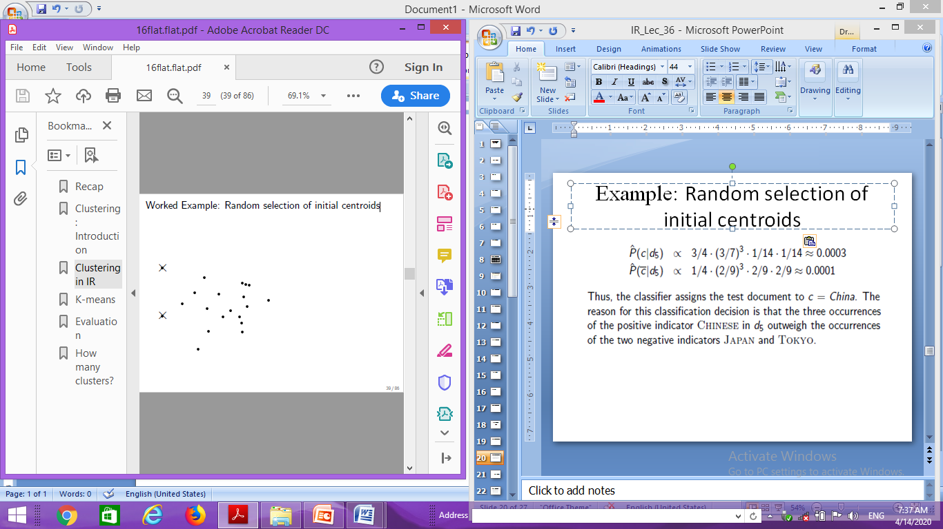
Example: Random selection of initial centroids

Slide 17
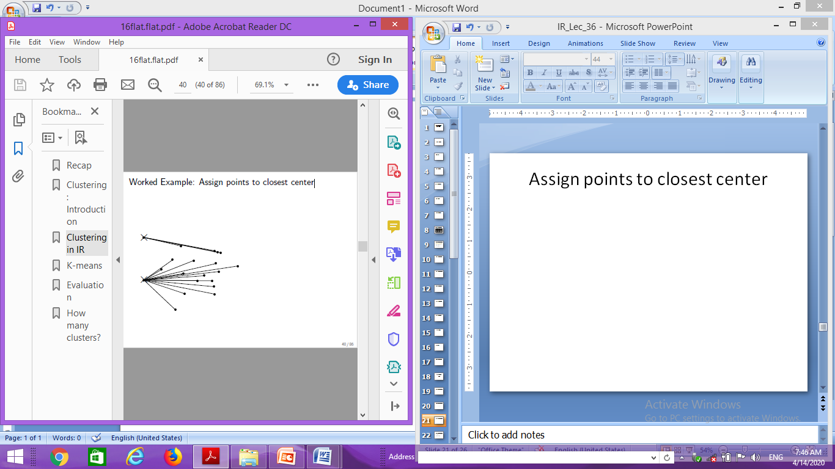
Example: Assign points to closest center

Slide 18
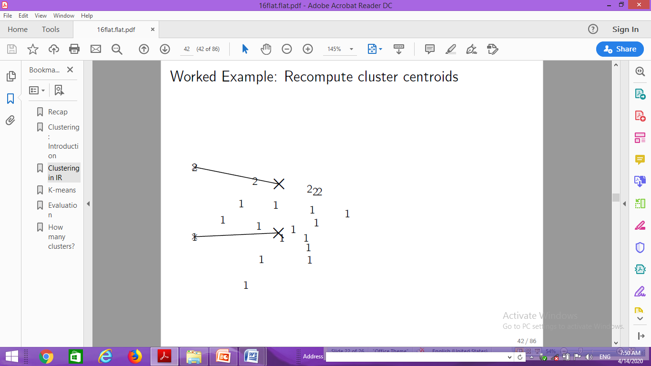
Example: Recompute cluster centroids

Slide 19

Example: Assign points to closest centroid

Slide 20
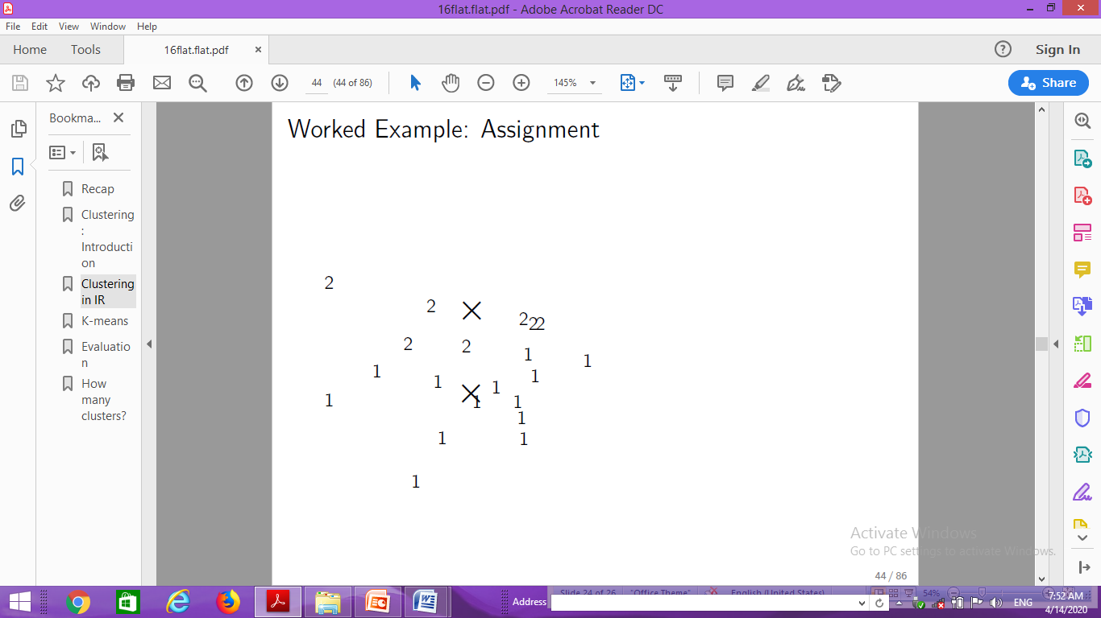
Example: Assignment

Slide 21

Example: Recompute cluster centroids

Slide 22
…

Slide 23

Example: Recompute cluster centroids

Slide 24

Example: Centroids and assignments after convergence

Slide 25
K-means is guaranteed to converge: Proof
RSS = sum of all squared distances between document vector and closest centroid
RSS decreases during each reassignment step.
because each vector is moved to a closer centroid
RSS decreases during each recomputation step.
There is only a finite number of clusterings.
Thus: We must reach a fixed point.
Assumption: Ties are broken consistently.
Finite set & monotonically decreasing → convergence

Slide 26
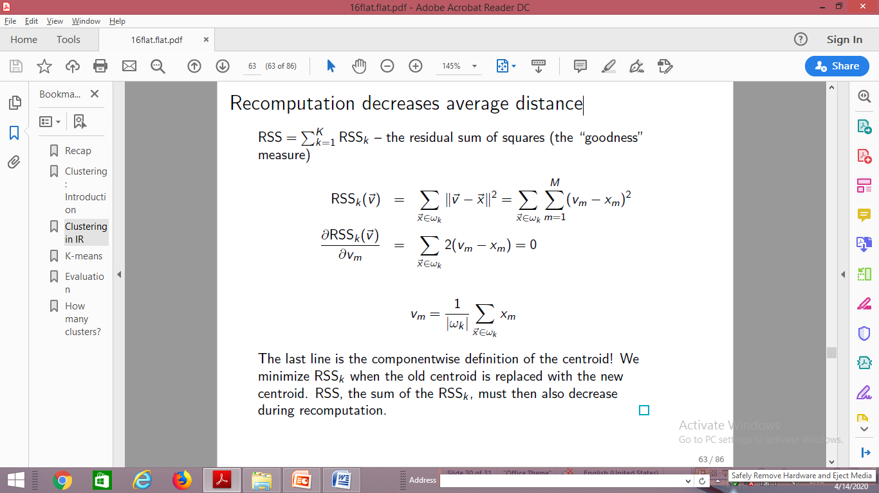
Recomputation decreases average distance
The last line is the componentwise definition of the centroid! We minimize RSS_{k} when the old centroid is replaced with the new centroid. RSS, the sum of the RSS_{k} , must then also decrease during recomputation.

Slide 27
K-means is guaranteed to converge
But we don’t know how long convergence will take!
If we don’t care about a few docs switching back and forth, then convergence is usually fast (< 10-20 iterations).
However, complete convergence can take many more iterations.

Slide 28
Optimality of K-means
Convergence optimality
Convergence does not mean that we converge to the optimal clustering!
This is the great weakness of K-means.
If we start with a bad set of seeds, the resulting clustering can be horrible.

Slide 29
Initialization of K-means
Random seed selection is just one of many ways K-means can be initialized.
Random seed selection is not very robust: It’s easy to get a suboptimal clustering.
Better ways of computing initial centroids:
Select seeds not randomly, but using some heuristic (e.g., filter out outliers or find a set of seeds that has “good coverage” of the document space)
Use hierarchical clustering to find good seeds
Select i (e.g., i = 10) different random sets of seeds, do a K-means clustering for each, select the clustering with lowest RSS

Slide 30
Evaluation

Slide 31
What is a good clustering?
Internal criteria
Example of an internal criterion: RSS in K-means
But an internal criterion often does not evaluate the actual utility of a clustering in the application.
Alternative: External criteria
Evaluate with respect to a human-defined classification

Slide 32
External criteria for clustering quality
Based on a gold standard data set, e.g., the Reuters collection we also used for the evaluation of classification
Goal: Clustering should reproduce the classes in the gold standard
(But we only want to reproduce how documents are divided into groups, not the class labels.)
First measure for how well we were able to reproduce the classes: purity

Slide 33
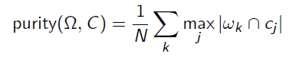
External criterion: Purity
= {ω₁, ω₂, . . . , ω_{K}} is the set of clusters and
C = {c₁, c₂, . . . , c_{J}} is the set of classes.
For each cluster ω_{k} : find class c_{j} with most members n_{kj} in ω_{k}
Sum all n_{kj} and divide by total number of points

Slide 34
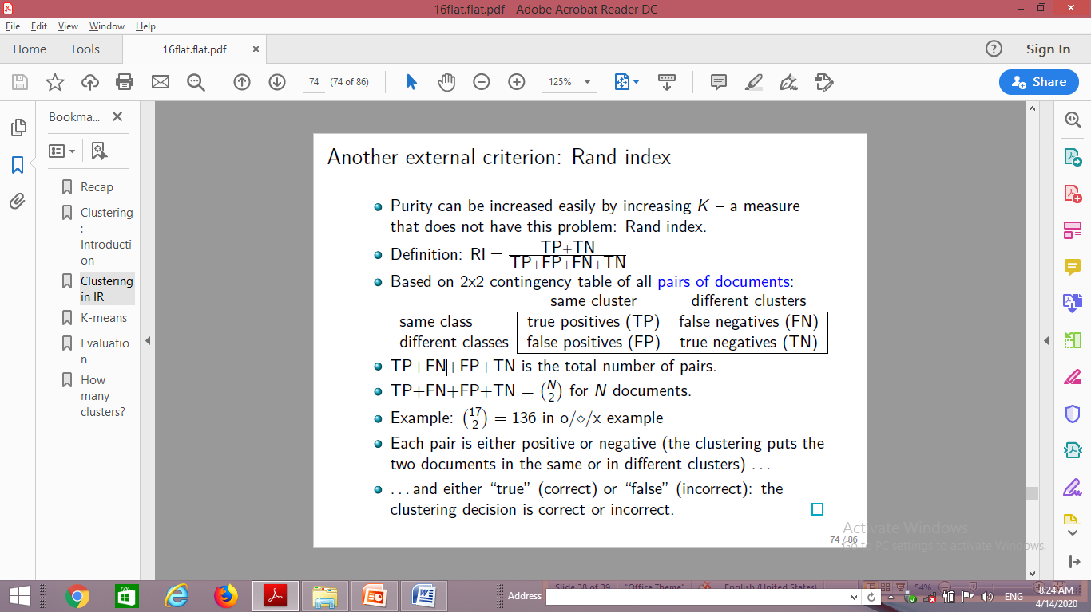
Another external criterion: Rand index

Slide 35
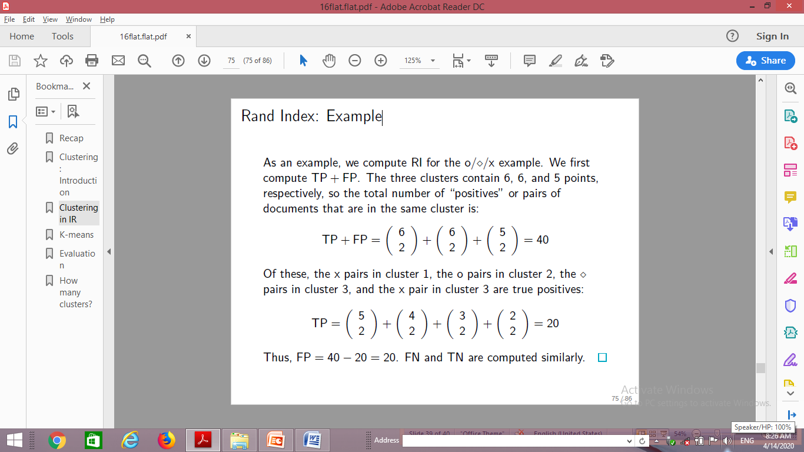
Rand Index: Example

Slide 36
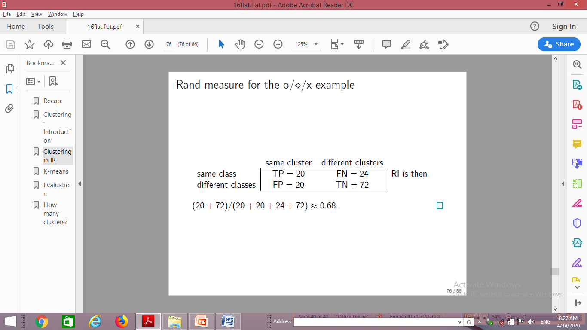
Rand measure for the o/⋄/x example

Slide 37
Two other external evaluation measures
Two other measures
Normalized mutual information (NMI)
How much information does the clustering contain about the classification?
Singleton clusters (number of clusters = number of docs) have maximum MI
Therefore: normalize by entropy of clusters and classes
F measure
Like Rand, but “precision” and “recall” can be weighted

Slide 38
Thank You

